Slide 1
Infrastructure as a Code

Slide 2
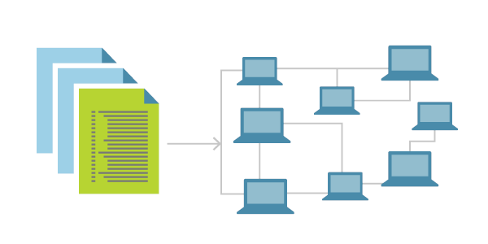
Infrastructure as a Code
Infrastructure as Code (IaC) is the management of infrastructure (networks, virtual machines, load balancers, and connection topology) in a descriptive model, using the same versioning as DevOps team uses for source code.
IaC model generates the same environment every time it is applied.
IaC is a key DevOps practice and is used in conjunction with continuous delivery.

Slide 3
Benefits
Consistency
Consistently achieve standardized provisioning or deployment
Accelerating
Accelerating provisioning or deployment rapidly
Reusability
Reusable JSON code for repeatable or similar provisioning or deployment
Extensibility
Extensible JSON code for incorporating with additional items

Slide 4
Manage Multiple Environments
Managing Environments :
Organizations often face challenges with inconsistencies between non-production and production environments. Infrastructure as Code (IaC) ensures uniformity by using the same configuration files for all environments, creating near-identical setups.
Dynamic Environment Provisioning :
IaC enables efficient provisioning of new environments, ideal for testing, debugging, or load testing. For instance, duplicating a production environment for security or performance testing becomes quick and reliable.
Scaling Production Environments :
IaC supports scaling by deploying consistent instances, facilitating geographic service expansion or specific deployment patterns.
Disaster Recovery :
IaC simplifies disaster recovery by recreating infrastructure in different regions, ensuring business continuity during downtime.

Slide 5
Understand Cloud Resources
Audit Changes
IaC configurations are version-controlled, allowing you to track, review, and understand changes, including who made them and when. This aids in identifying why resources are configured in specific ways.
Metadata for Clarity
IaC supports metadata like comments, enabling clear documentation of infrastructure decisions. Organizations should adopt the same documentation principles for IaC as for application code.
Unified Codebase
Combining application and infrastructure code helps developers better understand their relationship, especially when changes are grouped in feature branches or pull requests.
Deep Cloud Insights
Using IaC reveals Cloud's underlying resource models, offering explicit control and deeper understanding for configuration and troubleshooting compared to the getting information of the resources console/portal.

Slide 6
Provisioning infrastructure through software to achieve consistent and predictable environments.

Slide 7
Core Concepts
Defined in Code
Stored in source control
Declarative or Imperative
Idempotent and consistent
Push or pull

Slide 8

Infrastructure as Code Benefits
Automated deployment
Consistent environments
Repeatable process
Reusable components
Documented architecture

Slide 9




Automating Infrastructure Deployment
Using Source Control
Provisioning
Resources
Planning Update s
Reusing Templates

Slide 10
IaC tools in AWS
Imperative IaC involves writing scripts in a language like Bash, PowerShell, C# script files, or Python. These programmatically execute a series of steps to create or modify your resources. When using imperative deployments, it is up to you to manage things like dependency sequencing, error control, and resource updates.
Declarative IaC involves writing a definition of how you want your environment to look; the tooling then figures out how to make this happen by inspecting your current state, comparing it to the target state you've requested, and applying the differences.

Slide 11
Thank you!

